Slide 1

YouTube Like Application
:- by Nikhil R Patil

Slide 3
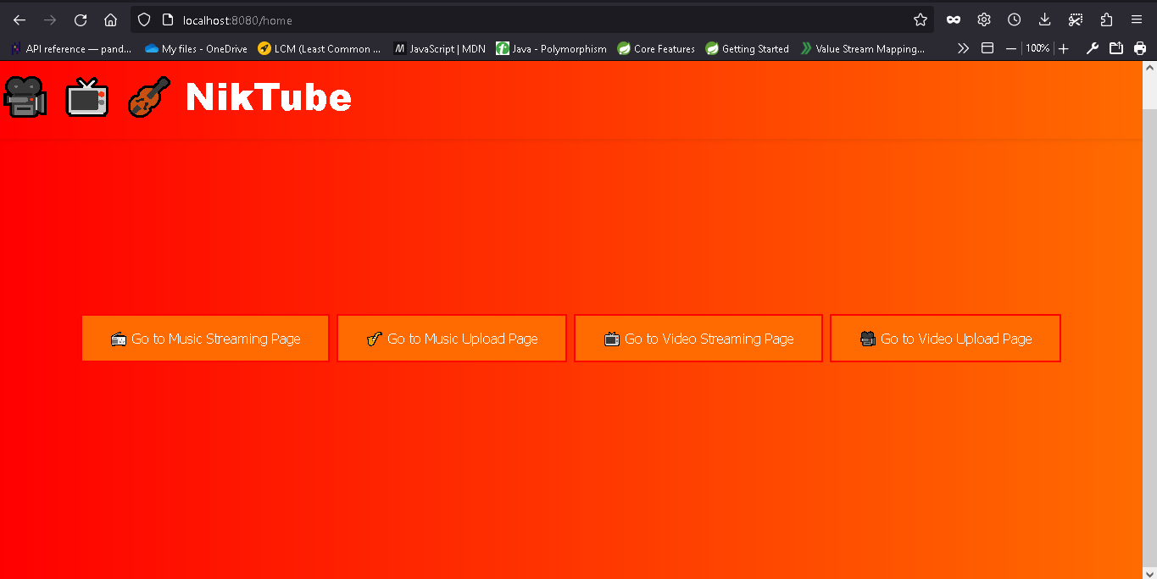
Home Page

Slide 4
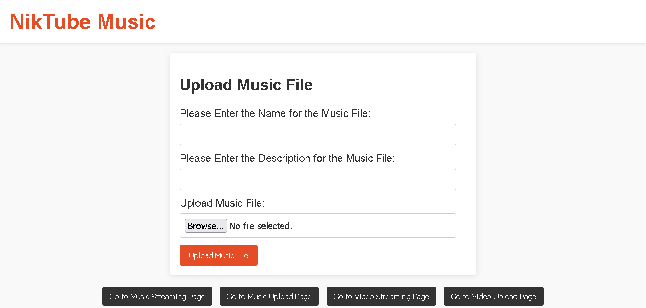

Slide 5
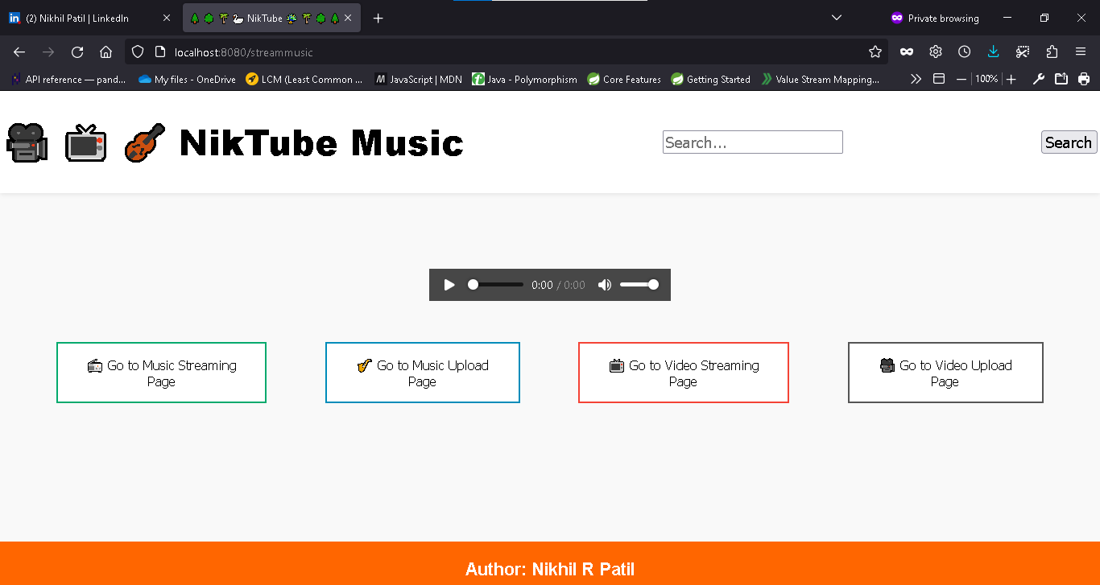
Music Streaming Page

Slide 6


Slide 7
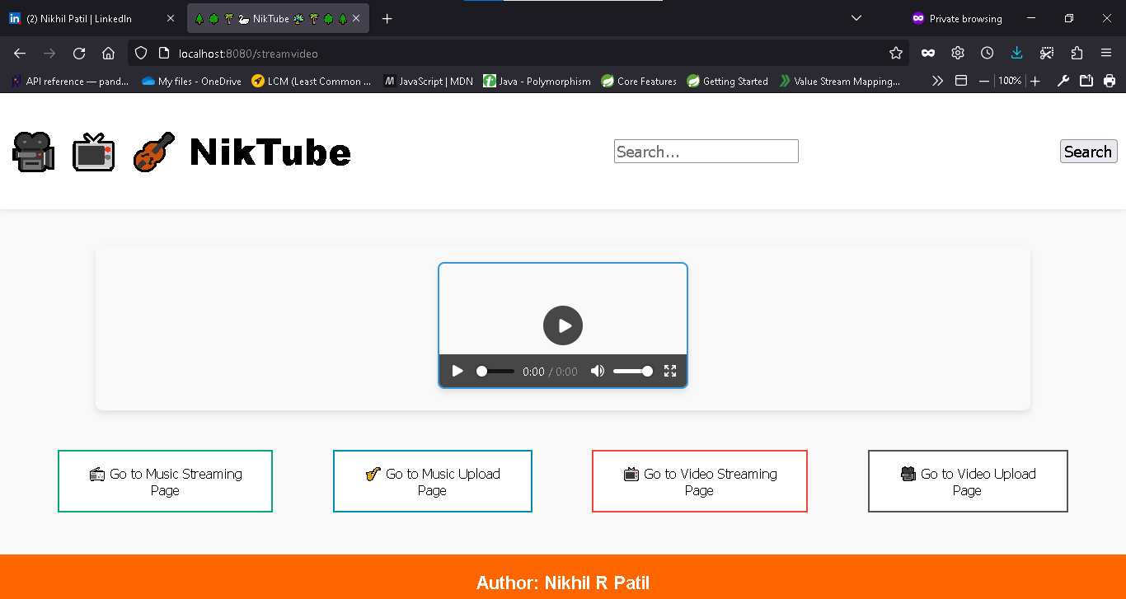
Video Streaming Page

